Slide 1
EMCC ASCEND 2018
Anthony Rietz, Ameyalli Santibanez, Javier Mancilla, Daniel Picasso, Jesus Chaidez, Richard Bernal, Kade Leonard, Selena Rodriguez

Slide 2
Team
Anthony Rietz: Biomedical Engineering
Ameyalli Santibanez: Civil Engineering
Javier Mancilla: Electrical Engineering
Daniel Picasso: Mechanical Engineering
Jesus Chaidez: Mechanical Engineering
Richard Bernal: Mechanical Engineering
Kade Leonard: Systems Engineering/Operations Research
Selena Rodriguez: Biomedical Engineering

Slide 3
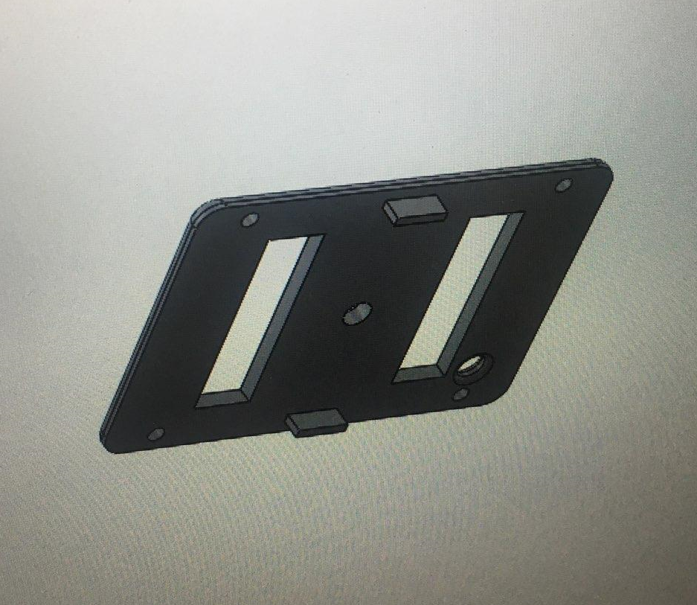
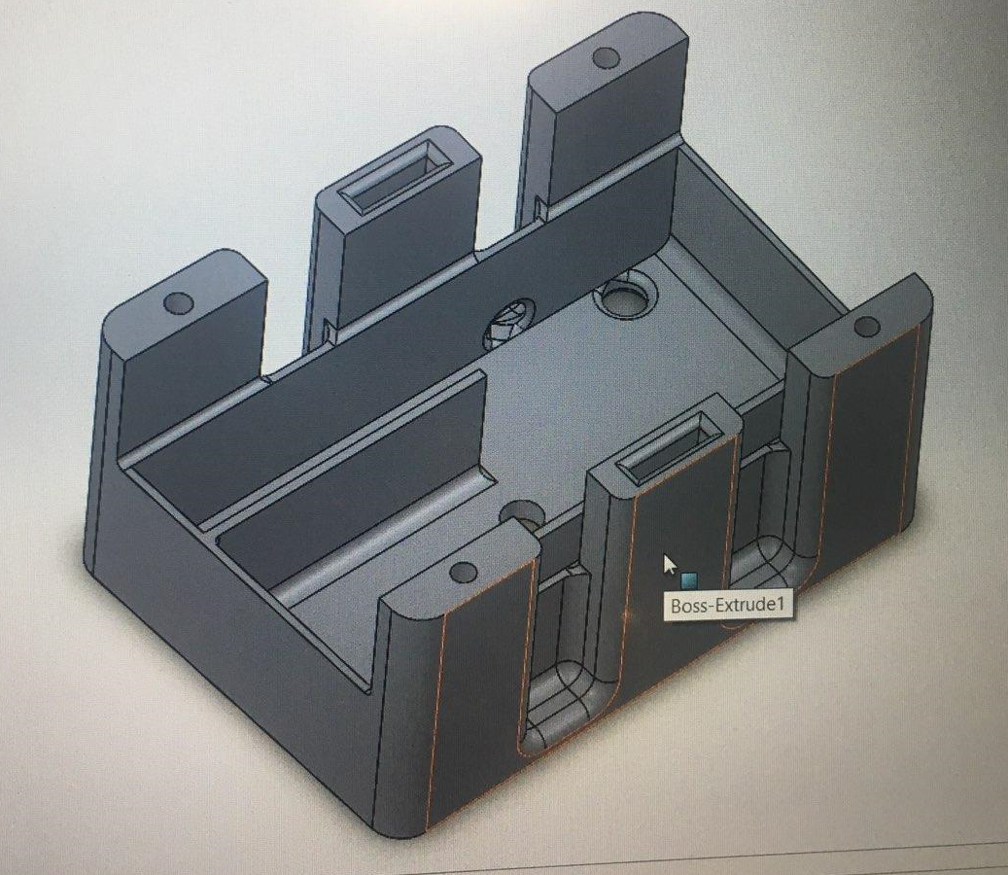
Design
Fall
Designed in Solidworks

Slide 4
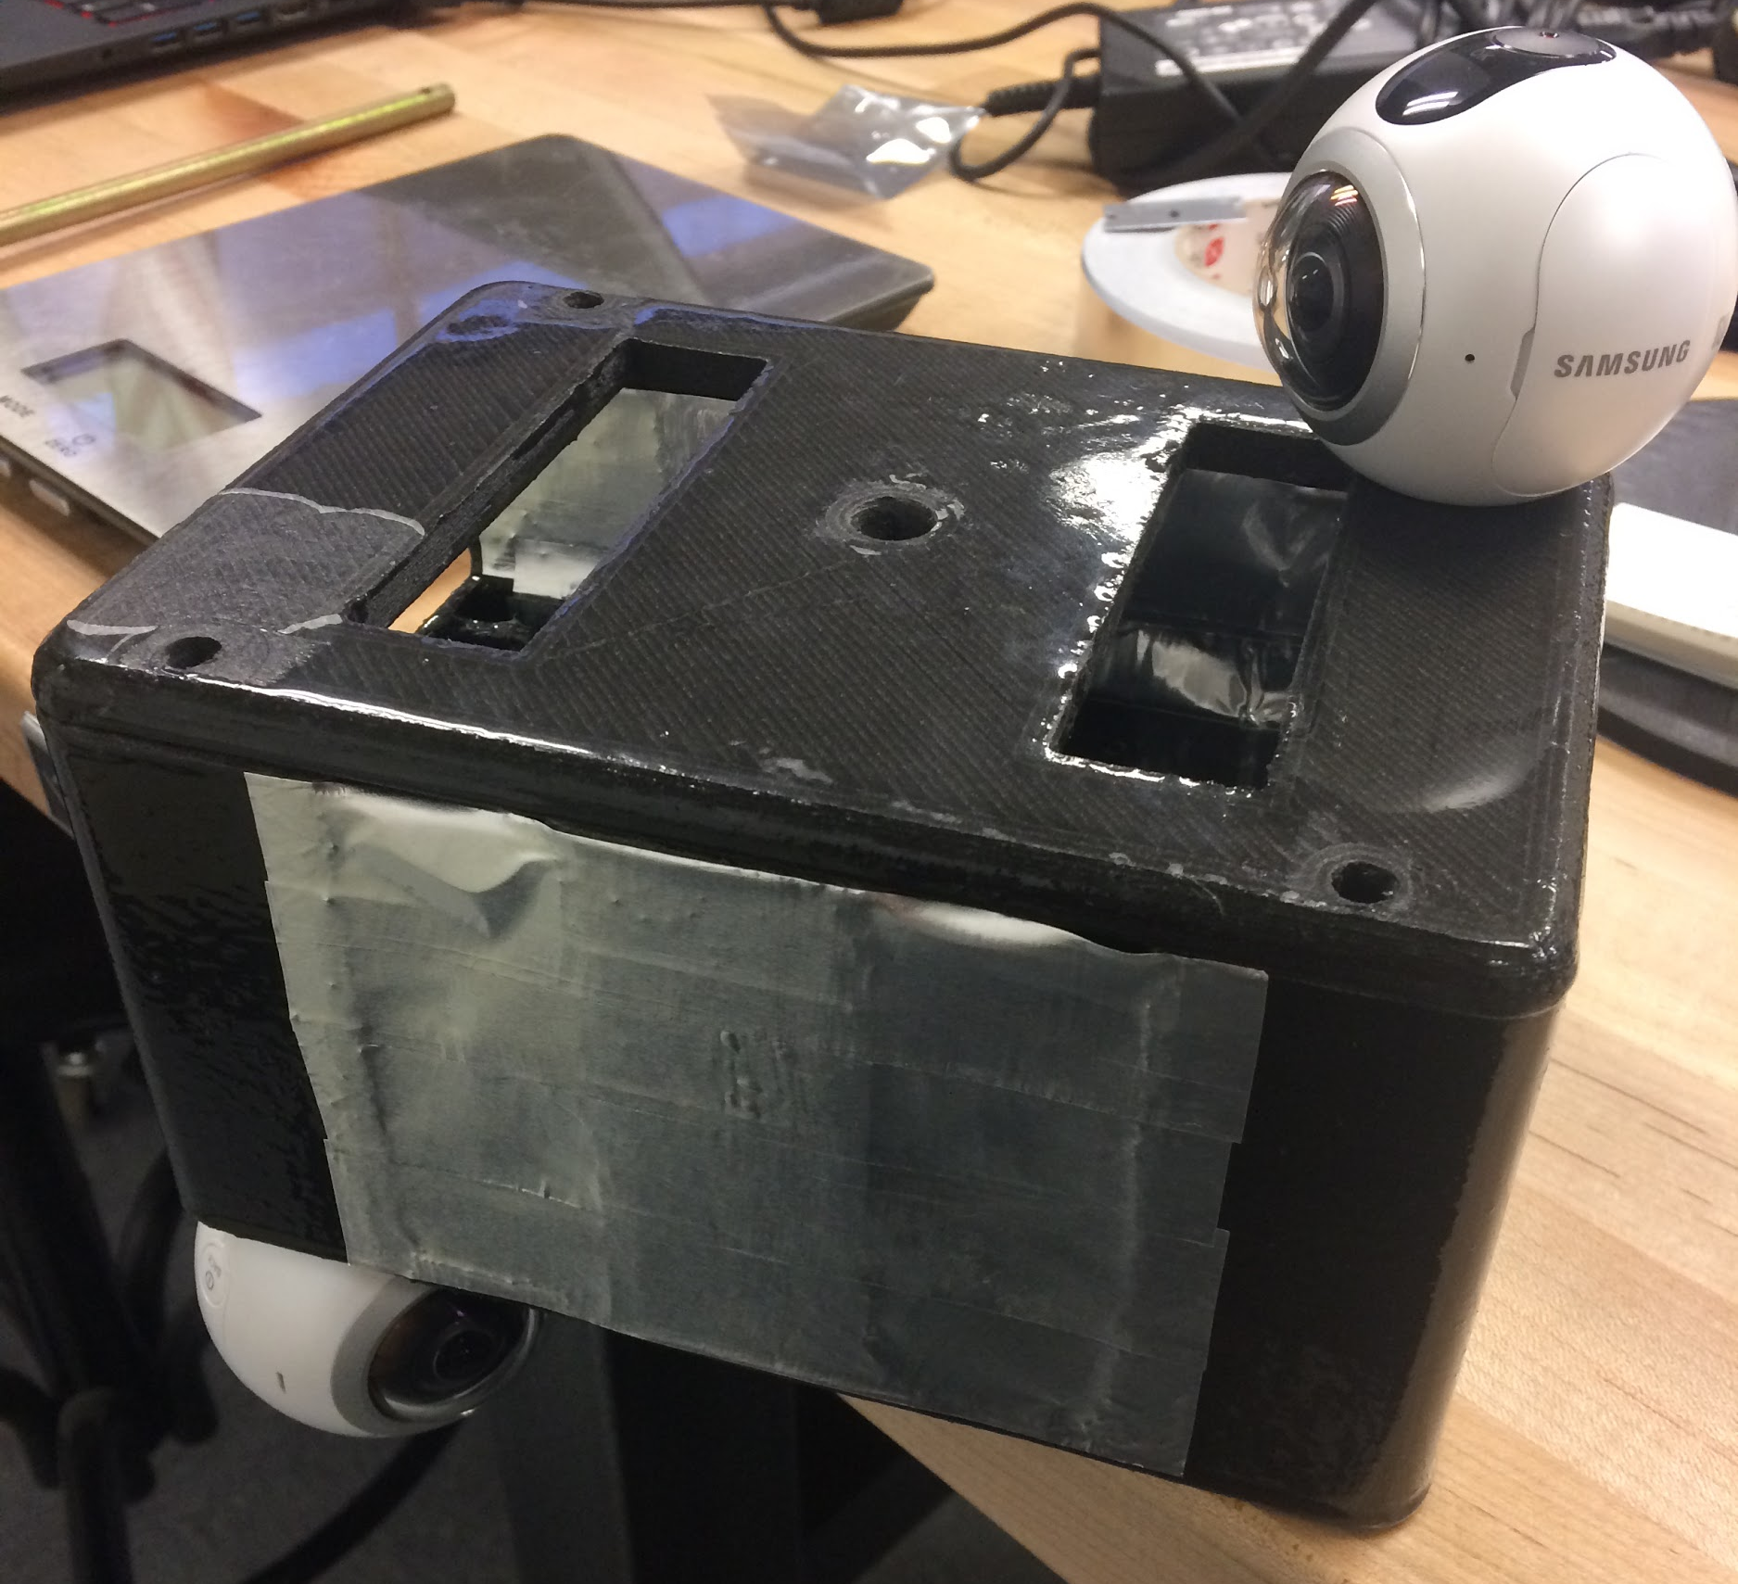
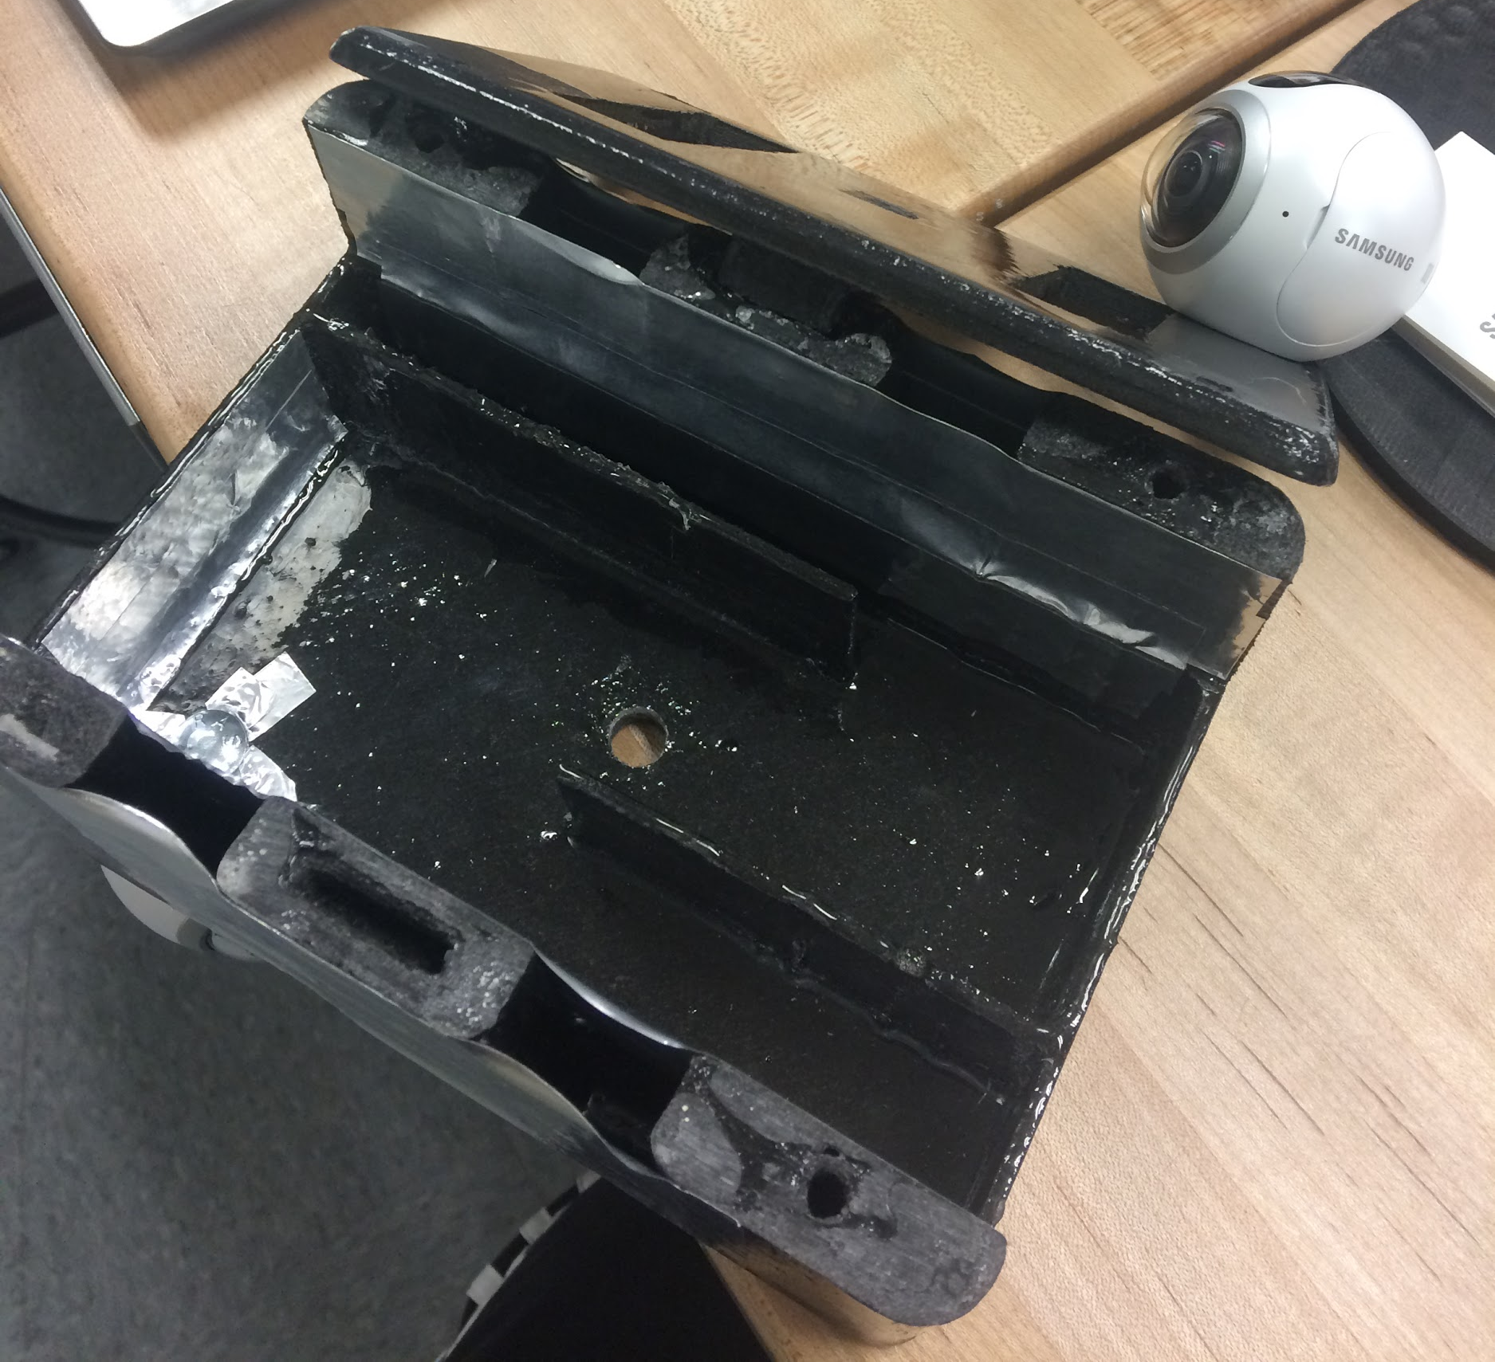
Structure
3D printed carbon fiber body
Aluminum insulation tape
Screws hold in cameras
2 part epoxy to prevent delamination

Slide 5
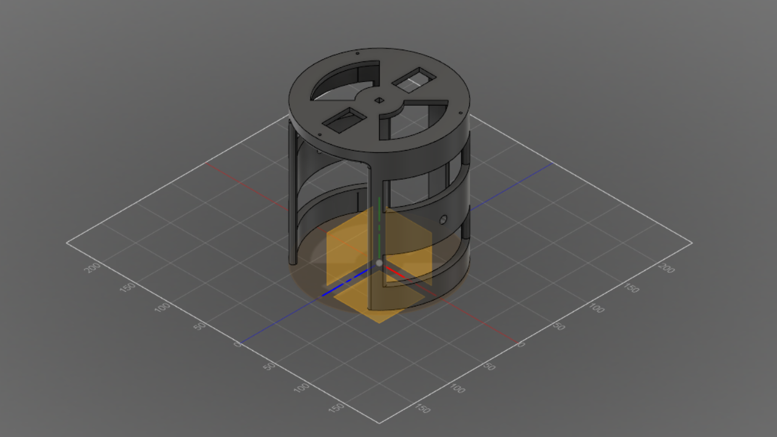
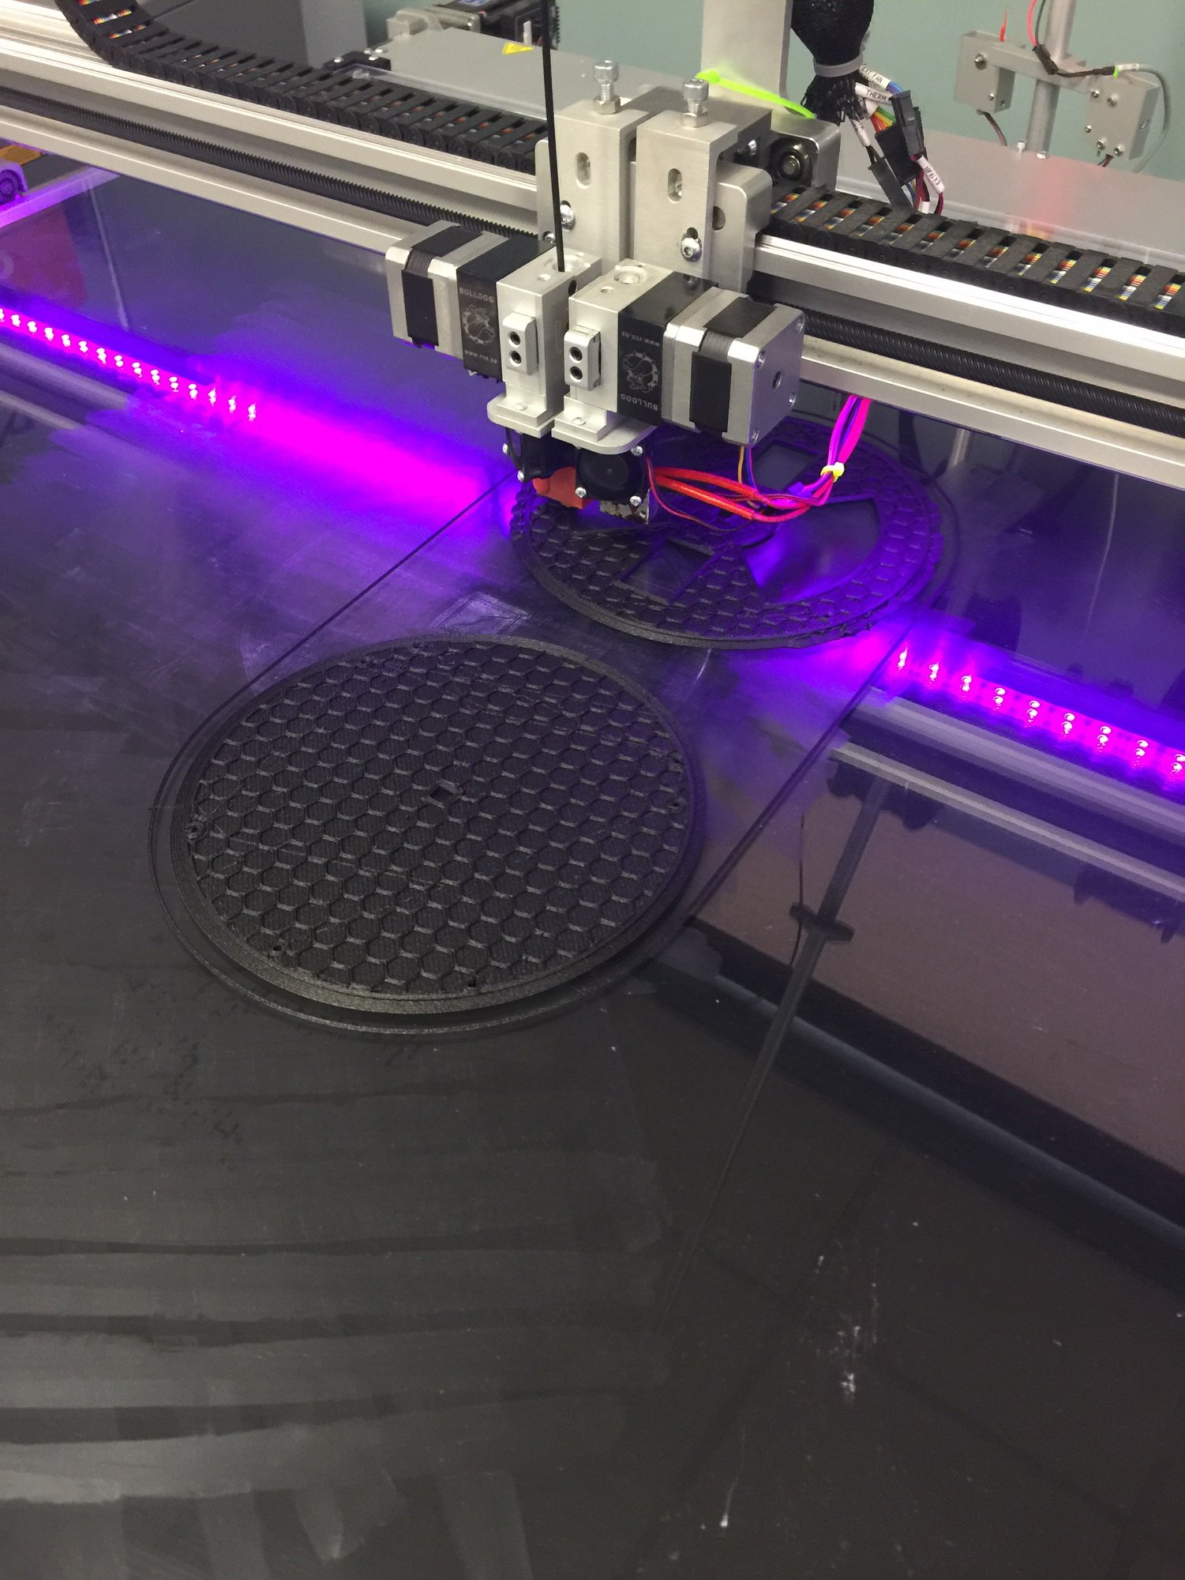
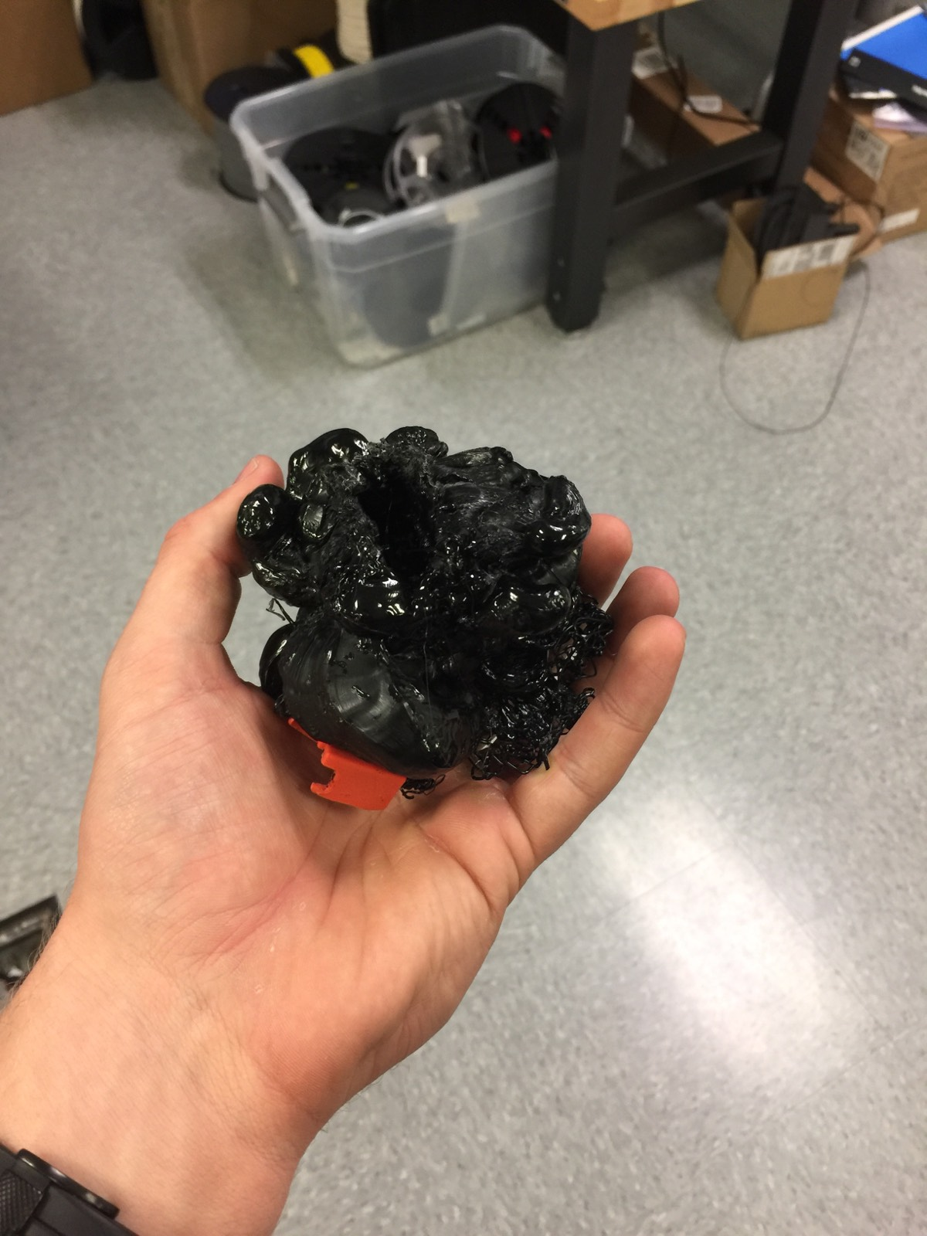
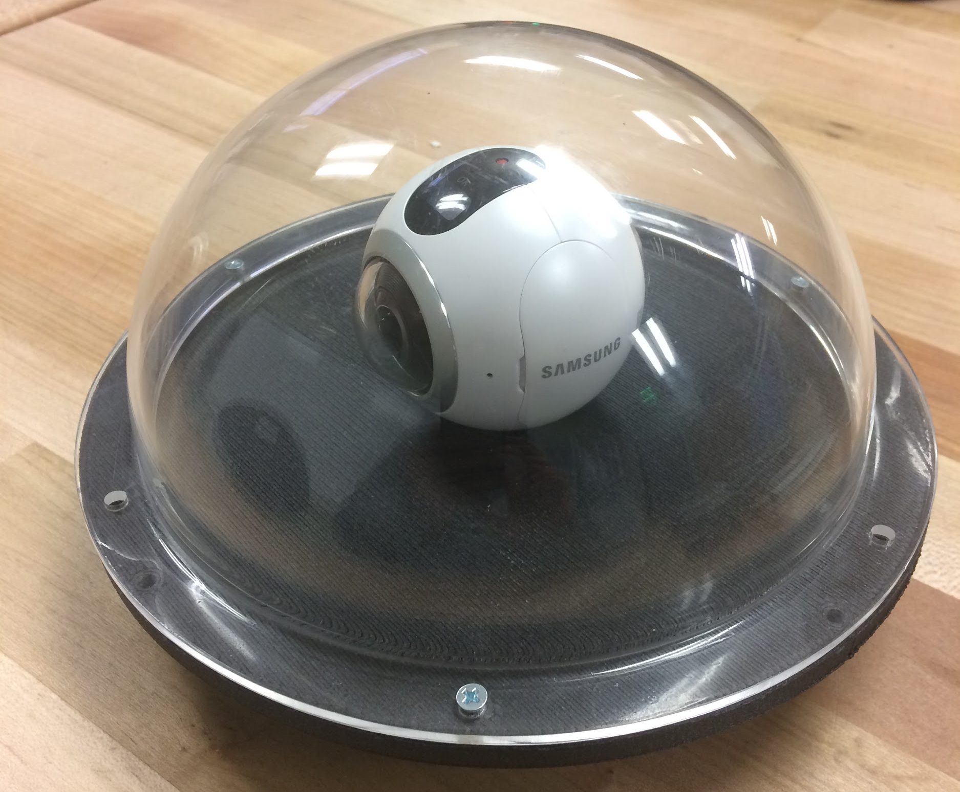
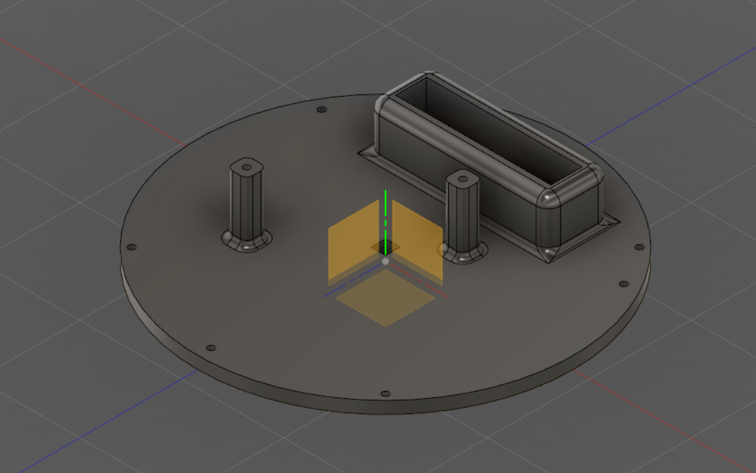
Spring Failed Design
Cylindrical
Includes 2 Domes
Failed on prints
Wanted Nylon X
Fusion 360
Video

Slide 6
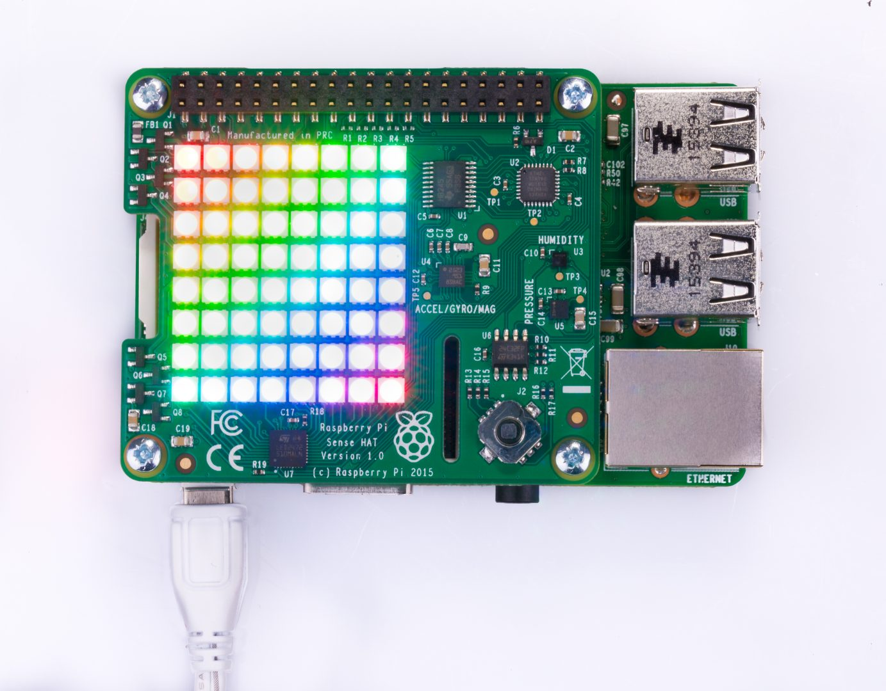
Payload
Sensors:
Sensehat:
  Gyroscope
  Accelerometer
  Magnetometer
  Temperature
  Barometric pressure
  Humidity sensor

Slide 7
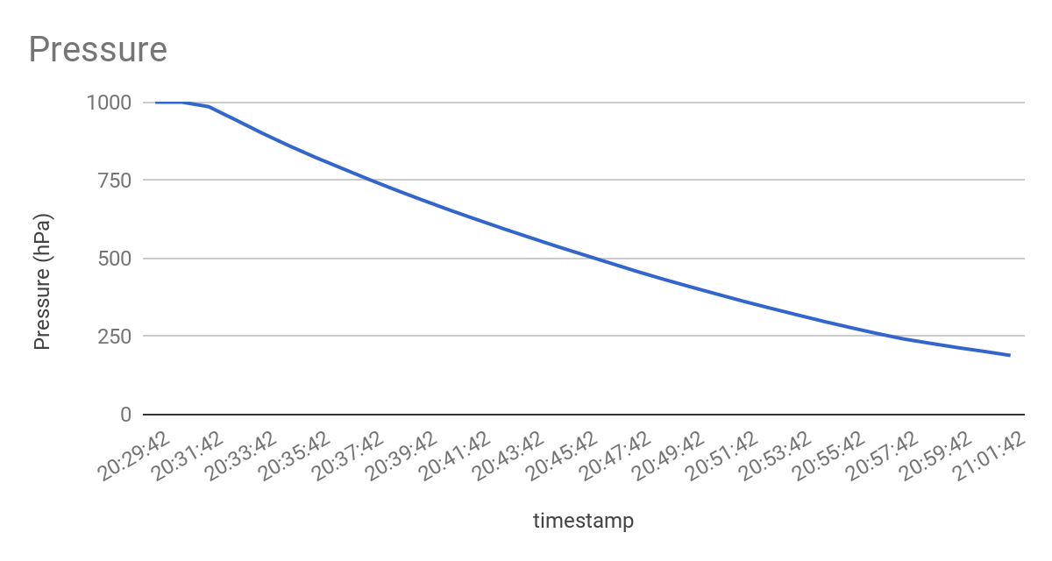
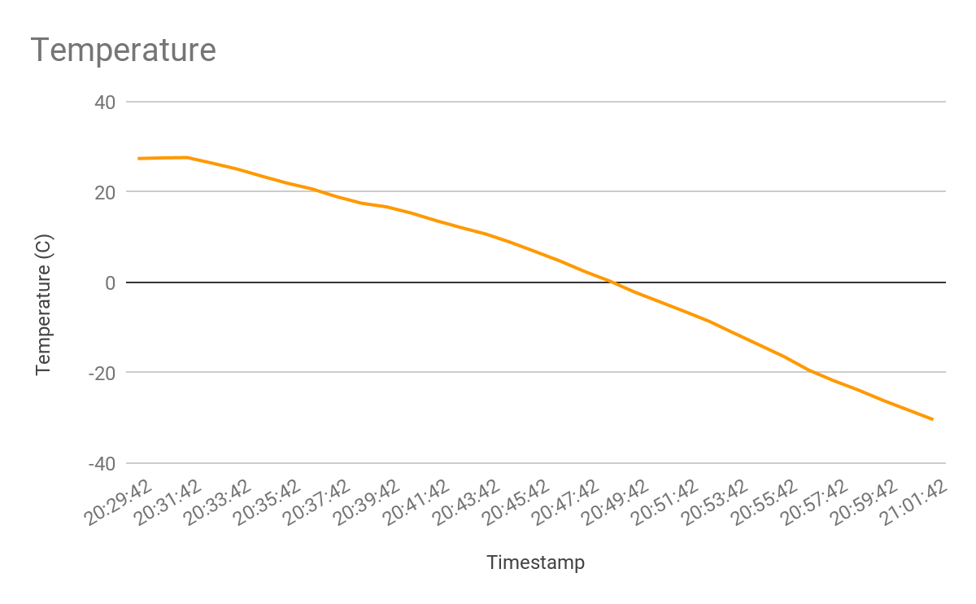
Data

Slide 8
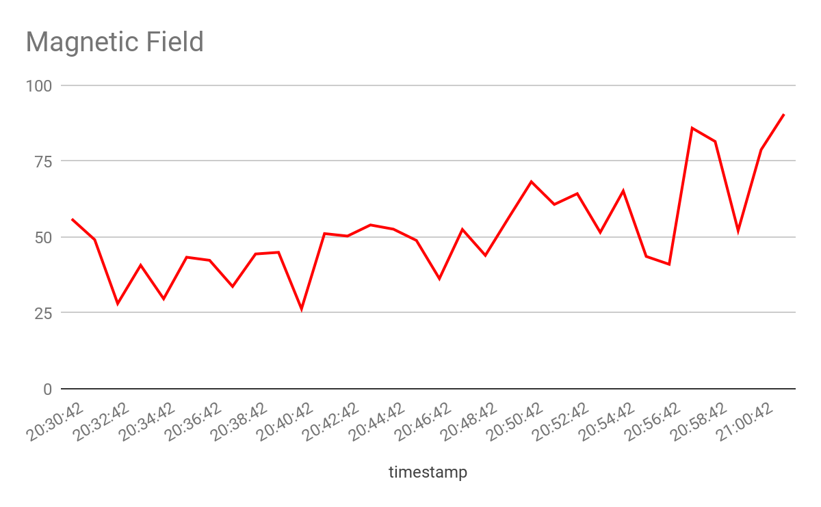
Magnetometer results

Slide 9
Conclusions
Sensor observations
  No real conclusive data to compare to last semester
Impact of human error
  Importance of practiced procedure
  Taking care when handling payload and components
Importance of scheduling/planning
  Start early enough for print
    Leave time for errors
  Have back-up plan
Survivability of designs

Slide 10
Thanks
AZ Space Grant Consortium
Susan Brew
ANSR Team
Steven Thomas
Clayton Jacobs
Bill McLean
NASA ASCEND Mentor
Mr. Rubio
Engineering Tutor
Jon Greenfield
Lab Tech
Darryl Ferra

